Slide 1
(More) Javascript
Vijay Velagapudi

Slide 2




Course Map
Getting Started
Front End
Back End
Advanced Topics
Fundamentals
Git
Command Line
HTML
CSS
Responsive Design
JavaScript & jQuery
Web Frameworks
Architecture
Database Design
APIs
Visualization
Security
Deployment

Slide 3
Front End Module - CSS
HTML
CSS & Responsive Design
JavaScript & jQuery

Slide 4
Agenda
Javascript Objects
Callbacks and Closures
Async
Code!

Slide 5
Recap

Slide 6
FizzBUzz – Try it! ~ 5 mins
Write a program that uses console.log to print all the numbers from 1 to 100, with two exceptions. For numbers divisible by 3, print "Fizz" instead of the number, and for numbers divisible by 5 (and not 3), print "Buzz" instead.
When you have that working, modify your program to print "FizzBuzz", for numbers that are divisible by both 3 and 5 (and still print "Fizz" or "Buzz" for numbers divisible by only one of those).
(This is actually an interview question that has been claimed to weed out a significant percentage of programmer candidates. So if you solved it, you’re now allowed to feel good about yourself.)
Borrowed from EloquentJS
Notes:
Just to wake everyone up and get them thinking about coding in Javascript
for (i=0; i<=100; i++) {
if (i % 5 === 0 && i % 3 === 0) {
console.log("FizzBuzz");
} else if (i % 3 === 0) {
console.log("Fizz");
} else if (i % 5 === 0) {
console.log("Buzz");
} else {
console.log(i);
}
}

Slide 7
Javascript Objects
Notes:
7 mins

Slide 8
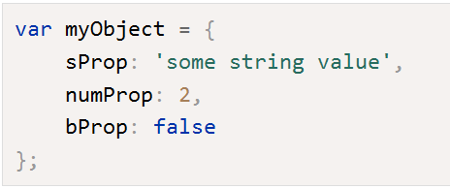
Javascript Objects
JavaScript is designed on a simple object-based paradigm. An object is a collection of properties, and a property is an association between a name (or key) and a value. A property's value can be a function, in which case the property is known as a method. In addition to objects that are predefined in the browser, you can define your own objects.
Notes:
https://developer.mozilla.org/en-US/docs/Web/JavaScript/Guide/Working_with_Objects
Objects can be compared to objects in real life.
Objects have properties.
Compare it with a cup, for example. A cup is an object, with properties. A cup has a color, a design, weight, a material it is made of, etc. The same way, JavaScript objects can have properties, which define their characteristics.
First Demo of Object:
var myFavoriteCup = {};
myFavoriteCup.color = "red“;
myFavoriteCup.showColor = function() { console.log("The color of the cup is " + this.color) }
myFavoriteCup.showColor()
In Javascript, functions are also objects and are referred to as “first-class” functions. This means that they can be treated in the same way as numbers, strings, or arrays. This is important distinction leads us to the next important topic about callback functions.
http://helephant.com/2008/08/19/functions-are-first-class-objects-in-javascript/
Second Demo of Functions as Object properties:
var outerFunction = function(innerFunction) { innerFunction(); }

Slide 9
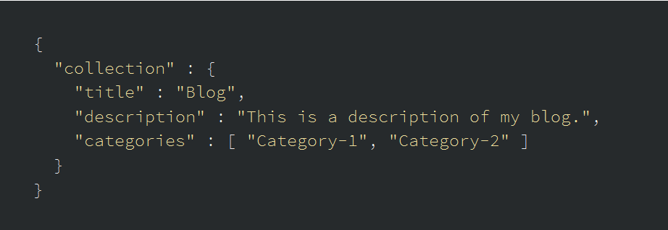
JSON
Notes:
Key: A key is always a string enclosed in quotation marks.
Value: A value can be a string, number, boolean expression, array, object, or null.
Key/Value Pair: A key value pair follows a specific syntax, with the key followed by a colon followed by the value. Key/value pairs are comma separated.
JSON is a format for structuring data to transmit data between a server and web application.

Slide 10
JSON
JSON, or JavaScript Object Notation, is a minimal, readable format for structuring data. It is used primarily to transmit data between a server and web application, as an alternative to XML.
Notes:
Source: http://developers.squarespace.com/what-is-json/
jsonlint.com
While JSON looks very similar to Javascript objects, JSON and Javascript Objects are different things.

Slide 11
CallBack Functions
Notes:
7 mins

Slide 12
Callback Functions
Callback functions are derived from a programming paradigm known as functional programming.
Used frequently in Javascript!
Fundamental to creating interactive websites
Notes:
Sometimes also referred to as Higher-order functions.
It is a function that is passed as a parameter to another function. The “callback” is executed inside of the function that it is passed to.
Because functions are first-class objects, we can pass a function as an argument in another function and later execute that passed-in function or even return it to be executed later.
Callback functions are probably the most widely used functional programming technique in JavaScript, and you can find them in just about every piece of JavaScript and jQuery code, yet they remain mysterious to many JavaScript
var txtNode = document.createTextNode("Hello. This is a new node.");

Slide 13
Closure
A closure is an inner function that has access to the outer (enclosing) function’s variables—scope chain. The closure has three scope chains: it has access to its own scope (variables defined between its curly brackets), it has access to the outer function’s variables, and it has access to the global variables.
A callback function is a closure.
Notes:
http://javascriptissexy.com/understand-javascript-closures-with-ease/
Inner function has access to outer function’s variables and the global variables.
Therefore, a function has access to variables within it’s own scope, it’s own variables, and it’s global variables.
Closures store references to the outer function’s variable

Slide 14
ASYNC
Notes:
5 mins
http://rowanmanning.com/posts/javascript-for-beginners-async/

Slide 15

Sync
In synchronous code, each statement of code is executed one after another
Notes:
The statements above will execute in order, outputting “First”, “Second”, “Third” to the console. That’s because it’s written synchronously.

Slide 16
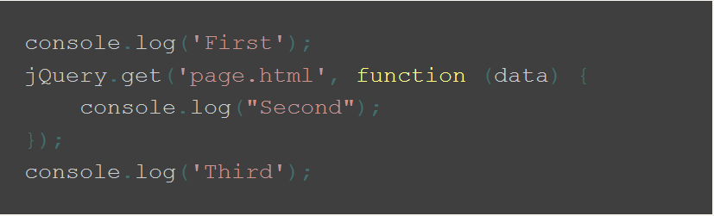
ASYNC
Statements can be executed “out of order”
Notes:
Asynchronous code takes statements outside of the main program flow
allowing the code after the asynchronous call to be executed immediately without waiting.
You’ve probably used asynchronous programming before with jQuery.ajax or similar

Slide 17
Why Async?
Synchronous code has the potential to block further execution until it has finished what it’s doing
Better UI Experience
CPU Usage
Notes:
long-running JavaScript functions can make the UI or server unresponsive until the function has returned
For example: if you want to load your latest tweets onto a web page, and you do this synchronously, then a visitor to your site won’t be able to do anything until those tweets are loaded.

Slide 18
Project Pitches on Friday
40% of your grade
Teams of 2-4
Deliverables
Working accessible application
Front End & Back End
Final Report and 2 Presentations
Dates
Ideas due 12th Feb (optional 2 Slides, 2 Minutes per pitch)
Team submissions and proposal due 19th Feb(BCourses)
Presentation and Report (May - TBD)
Notes:
Quick show of hands for people who already have project teams
Quick show of hands for people who want to pitch on Friday (It’s optional)
Actual proposal due on 19th of February
As a general rule of thumb, you use asynchronous code when performing expensive and time-consuming operations. You wouldn’t use it to change a CSS class on an element, for example.

Slide 19
Lab
Notes:
Remainder of class

Slide 20
Instructions
Find a partner you haven’t worked with before
Only one computer should be open!
I am going to give you a set of requirements and I want you to build me a webpage using HTML, CSS, and Javascript.
After you complete each set of requirements, let me know and, I will give you the next set of requirements.
After you complete each set of requirements, write down on a piece of paper how difficult it was to complete that task on a scale of 1-10 and how confident you are in the stability of your code on a scale of 1-10.
Notes:
I am going to give you a set of requirements and I want you to build me a webpage using HTML, CSS, and Javascript.
After you complete each set of requirements, let me know and I will give you the next set of requirements.
After you complete a set of requirements, write down on a piece of paper how difficult it was to complete that task on a scale of 1-10 and how confident you are in the stability of your code on a scale of 1-10.

